Slide 1

Agricultural Crop Yield in Indian States Analysis using Azure

Slide 2
agenda
Project Overview Project Requirements Data Overview Project Workflow Architecture Diagram Outcomes Conclusion

Slide 3

Project overview
This project focuses on exploring and optimizing agricultural crop yield data stored in a data lake using PySparkSQL and Azure Databricks.
The dataset includes crop production data from Indian states (1997-2020), with key features such as crop types, yields, rainfall, fertilizer, and pesticide usage.
By leveraging the power of Azure Databricks and Azure Data Lake, we aim to efficiently process large datasets, perform advanced analytics, and optimize queries for better insights into crop yield patterns and factors influencing agricultural productivity.

Slide 4
Project requirements
Azure Databricks
An Apache Spark-based analytics platform optimized for Azure.Provides collaborative development environments for data engineers and data scientists.
Enables real-time data processing and advanced analytics using SparkSQL and PySpark. Seamlessly integrates with other Azure services like Azure Data Lake for efficient data analysis.
Azure Data Lake
A highly scalable and secure data storage solution for large datasets.Designed to store and manage vast amounts of unstructured data.
Supports efficient querying and analytics, integrated with Azure Databricks for advanced processing.Offers hierarchical namespace for easy data organization and management.

Slide 5
Data overview
Dataset Source: The dataset is available on Kaggle, a popular platform for datasets, and provides extensive agricultural data for Indian states from 1997 to 2020.
Data Coverage: It includes information about various crops, including their types, production, and environmental conditions, across multiple states in India.
Key Variables: The dataset features key variables such as crop year, area under cultivation, production, rainfall, fertilizer usage, and pesticide usage, which help in yield prediction.
Data Quality: The dataset provides a rich source of clean, structured data, ideal for performing advanced analytics and optimizations with tools like PySparkSQL.

Slide 6
Project Workflow
1. Data Access with Azure Databricks::
Use Azure Databricks to connect to Azure Data Lake and access the data using the account key for secure access.
Access the data stored in a CSV file format (e.g., crop_yield.csv) from the Data Lake using PySpark
2. Data Exploration and Analysis:
PySparkSQL is used to load, explore, and analyze the data from the Data Lake.
Perform basic operations like viewing the data schema and displaying sample records using Spark DataFrame methods.

Slide 7
Project Workflow
3. Data Optimization:
Leverage Spark to perform any necessary optimizations such as filtering, transforming, or aggregating the data efficiently for analysis.
Perform additional optimization by leveraging Spark's built-in functions to improve the overall performance of the data processing tasks, ensuring faster execution times during exploratory data analysis and subsequent transformations.

Slide 8
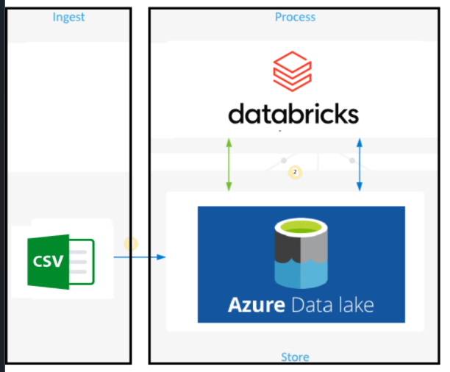
Architecture diagram

Slide 9
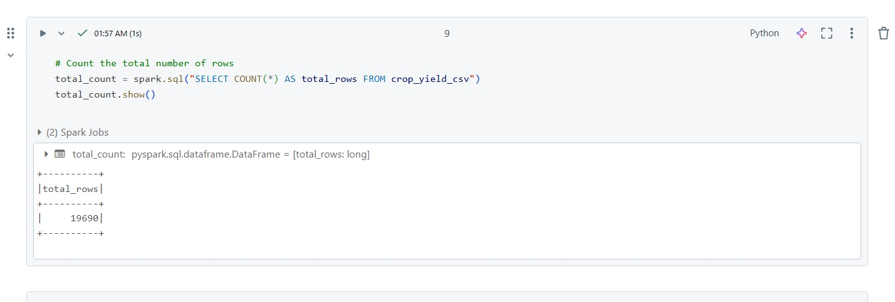
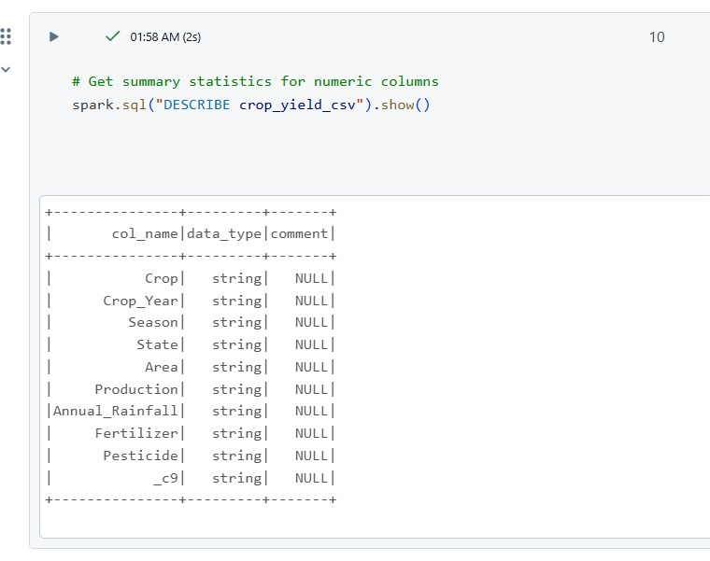
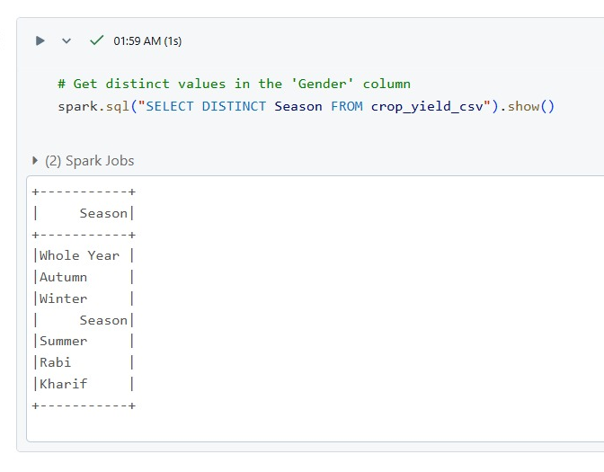
Outcomes -SparkSQL

Slide 10
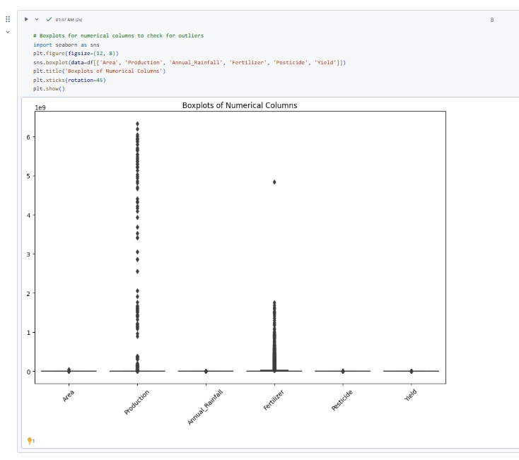
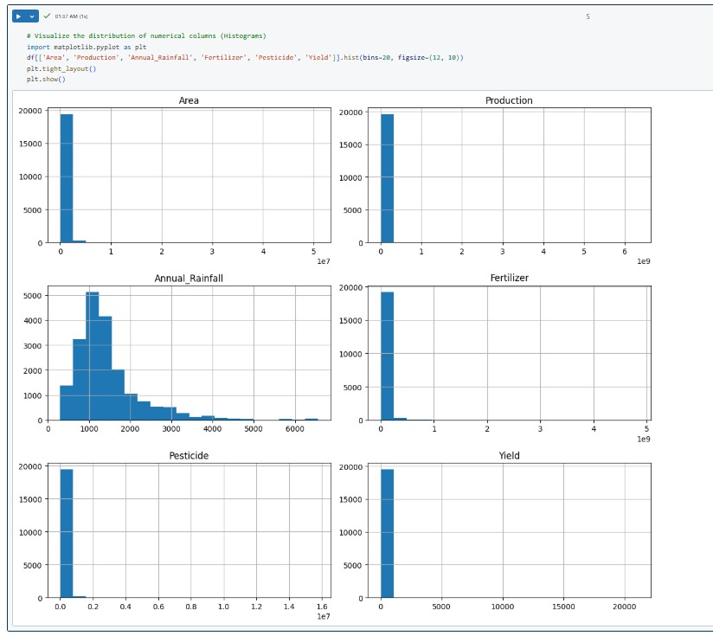
Outcomes - Analysis

Slide 11
Conclusion
This project demonstrates the effectiveness of Azure Databricks and Azure Data Lake in exploring and optimizing large agricultural datasets.
By utilizing PySparkSQL, we were able to efficiently query and analyze crop yield data, gaining insights into factors such as rainfall, fertilizer use, and cropping seasons.
The optimizations applied to Spark queries improved performance and scalability, making the analysis more efficient.
The project underscores the potential of cloud-based solutions for data exploration, enabling better decision-making and predictions in agriculture. These methods can also be extended to other industries for enhanced data analysis and optimization.

Slide 12
Thank you
Abhilash gowda s
Mahesh Ratneshwar Godale

